Slide 1
Advanced Environmental Systems Analysis (AESA) I.C. 10 credits
1st MOD: Giorgio Guariso, DEIB, Building 20,Office 201, 2nd floor. From Sep 12 to Oct 25
Tel. 02 2399 3559, giorgio.guariso@polimi.it
2nd MOD: Matteo Giuliani, DEIB, Building 21, Office 2.13, 2nd floor. From Oct 26 to Dec 21
Tel. 02 2399 9040, matteo.giuliani@polimi.it
The course is about 30+30 hours lectures plus about 20+20 hours practice.
Syllabus (1st module) .Tentative program (1st module).

Slide 2
“Don't just teach your students to read. Teach them to question what they read, what they study. Teach them to doubt. Teach them to think”
Richard Feynman

Slide 3
Advanced Environmental Systems Analysis (AESA) I.C. 10 credits
1st MOD: Models for environmental quality planning
Environmental decision making within the DPSIR approach. Environmental planning and management problems at a regional/local level are formulated according to the specific compartment addressed within the EU DPSIR scheme. The role of the model of the environmental system is highlighted.
The general transport and dispersion equation.
Water quality modelling and planning (SDG6). Simple BOD-DO models are formulated for a river system, composed of various reaches. The model is then enriched looking at: Hydraulic model and mass balance equations; The dynamics of bacteria and ecological food chain; Biological and nutrient compartments. Integrated land and river models (SDG2) and lake models will also be presented. All such models can be used to determine localization and discharge decisions in water bodies. Surrogate modelling is finally introduced as a tool to solve computationally intensive decision-making problems.
Air quality modelling and planning. (SDG11) The cases analysed will cover a set of common situations: Non-reactive pollutants in stationary conditions; Climatological models and the role of meteorology; Models of specific situations (coastal, urban canyon); Models for reactive pollutants (Lagrangian, Eulerian, particle chemical transport models). Boundary conditions problems and nesting techniques will be discussed. The course will illustrate how to use these models in emission reduction planning (SDG7) and how to join them with health impact models to develop integrated regional plans.
CO₂ emissions and biomass exploitation (SDG15). Gaseous emissions also imply the release of CO₂ into the atmosphere. It is thus necessary to formulate carbon budget models, taking into account its major sinks: biomass and soil. To optimally plan for CO₂ capture (SDG13) and bioenergy production (SDG12), we examine vegetation dynamics and forest management.

Slide 4
Advanced Environmental Systems Analysis (AESA) I.C. 10 credits
2nd MOD: Decision making under global changes
modelling global changes
climate modelling
land use changes modelling
energy demand and resources models
robustness, risk and uncertainty
the IPCCS scenarios and their consequences
decision making under uncertainty

Slide 5
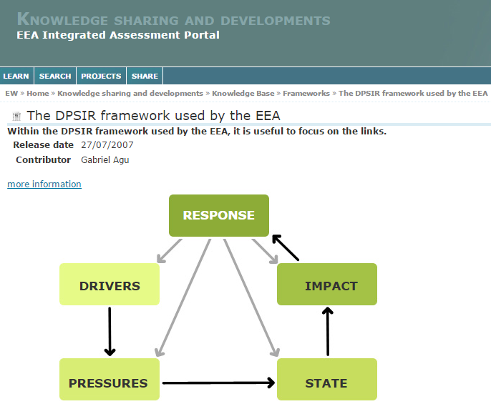
The approach: DPSIR
The DPSIR scheme helps “to structure thinking about the interplay between the environment and socioeconomic activities”, and “support in designing assessments, identifying indicators, and communicating results” (EEA, 2012).

Slide 6
Drivers (driving forces)
“Actions resulting from or influenced by human/natural activity or intervention”
Normally related to large-scale socio-economic trends
Leading to significant variations of PRESSURES
More meaningful at national/continental level than at local level
Examples: population dynamics, industrial and agricultural changes, human mobility, climate changes,..
Often measured by variables (sometimes called “activity levels”) describing traffic, industries, residential heating, etc…
Inducing their changes (RESPONSE) requires extensive action and long time (e.g. education)

Slide 9
Pressures
“Discharge of pollutants into the environment”
Normally, more local phenomena linked to the specific situation of the territory (e.g. type of agriculture, level of waste disposal services,…)
Leading to significant variations of STATE
Often measured by variables (called “emission levels”) describing amount of pollutant produced and disposed into the environment
Examples: amount of solid wastes, waste waters, fertilizer drainage, NO₂ emissions from cars,…
Inducing their changes (RESPONSE) requires both technological (e.g. new filters, new processes) and non-technological (or efficiency) changes (e.g. use bicycles instead of cars).
Mostly evaluated indirectly (proxy variables).

Slide 10
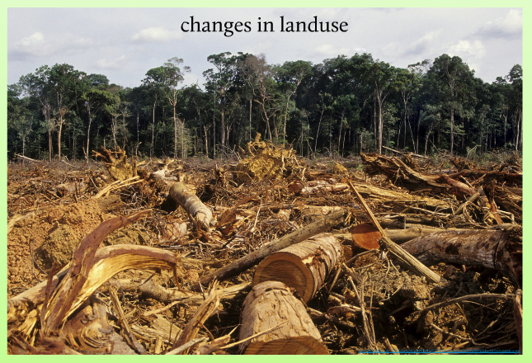
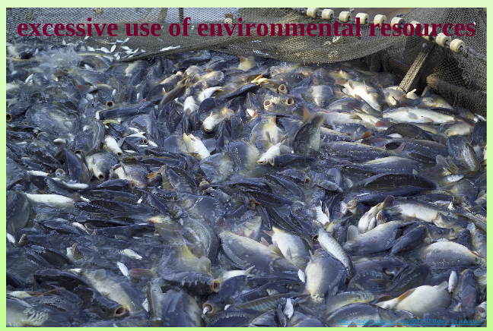

Slide 12
State
“Condition of different environmental compartments and systems”
Normally easy to measure in a single spot (monitoring)
Often measured by variables (mostly called “concentration”) at a specific point in time and space, by specific gauges.
More difficult to evaluate at a territorial level (indicator) and as an overall environmental condition (several indicators → index)
Examples: BOD or TOC or pathogens concentration, Ozone peaks, number of days with PM2.5 above a threshold,...
Leading to significant variations of IMPACTS
Inducing their changes (RESPONSE) requires large and expensive technical tools (the pollutants are already in the environment) e.g. collection and treatment of wastes; aerators; PM fixing trees.

Slide 14
Impact(s)
“Any alteration of conditions, adverse or beneficial, caused or induced by the variation of the state of the environment”
Normally related to some territorial entity (NUTS 2, NUTS 3)
Requiring some kind of RESPONSE(S)
May be measured in several different ways in different sectors
Examples: number of cases, area acidified, loss of vegetation, reduction of species, monetary damage,..
Inducing their changes (RESPONSES) may require both technical (e.g. noise barriers along the highways) and non-technical (e.g. warning systems to reduce population exposure) actions.
P. S. A key question is “alteration with respect to what?”

Slide 16
Response(s) -1
“Attempts to prevent, compensate, ameliorate or adapt to changes in the state of the environment”
They strongly depend on the structure and responsibility of the governing entities
They may be constrained by decisions taken at higher levels (e.g. EU)
They often require some form of investment (e.g. money, learning)
Examples: impose new norms on energy in residential buildings, establish new emission standards for cars, subsidized bio-based agriculture, build new infrastructures,…
Can be defined using two computer-supported approaches:
Scenario based
Optimization

Slide 17
Response(s) - 2
Scenario analysis
This is the approach mainly used at the moment to design “Plans and Programs” at regional/local scale, selecting actions on the base of expert judgment and testing the effects through a suitable model of the environment. This does not guarantee that cost-effective measures are selected and it is mainly used for “ex-post evaluation” of costs and other impacts.
Optimization
This approach allows for an “automatic” selection of cost-effective measures, solving an optimization model. This means that a “feedback” is provided on the “effectiveness” of the measures, in terms both of costs and effects. To perform the optimization, one needs to embed in the overall procedure, a suitable model of the environment AND a model of the (relevant) impacts.

Slide 18
(Some relevant) Problems
The policy domain does not coincide with the physical domain
Decisions that can be taken by a governing agency may be implemented in a geographical area (policy domain) quite different from the physical domain determining the environmental conditions (e.g. decision taken by a regional authority on a portion of a nation-wide river basin).
Models can be calibrated only on past/current data
The model represents (with known accuracy) the past/present environmental conditions. Its ability in representing (new) modified conditions is unknown (representativeness?).
Data-based models (e.g. ARMA models) cannot be used for planning new systems: physically based models are needed, but they may be computationally very heavy (difficult to embed into an optimization procedure).

Slide 19
Course topics (1st MOD)

Slide 20
Examples
Determine the optimal position of a new pollutant discharge along a river
Definition of an optimality criterion
Model of the river system
Constraints on the available locations
Determine the least costly abatement measures to reach a given air quality in a region
Definition of air quality
Model of the air pollution over the region
Constraints on the available technologies and their applicability

Slide 21
Course topics (2nd MOD)

Slide 22
A dynamic view of the links
v_{d}(t)
external
conditions
u_{p}(t)
Economy/Societal dynamics
Pressure evaluation
u_{d}(t)
decisions
A(t)
activities
E(t)
output
u_{s}(t)
u_{i}(t)
Environmental system dynamics
Impact
evaluation
E(t)
emissions
x(t)
state
y(t)
output
external
conditions
v_{s}(t)
The dynamics of the first system is much slower than that of the second, thus all the variables of the first system can be considered as constant when evaluating the second.

Slide 23
Data needs and expected outcome
Ex.
Environmental system dynamics
Impact
evaluation
u(t)
decisions
x(t)
state
y
output
external
conditions
v(t)
To understand the effects of a decision, all other conditions must be known for all the relevant horizon
The initial condition of the system must be fixed/known
All the boundary conditions must be fixed/known
The decisions must produce a significant (meaningful) change of the state
The approach is intended to compare alternatives NOT to forecast the future (future external conditions will be different) → decision support

Slide 24
The general decision problem (1)
Assuming:
u(t) is the vector of decisions (values or functions) (RESPONSE)
x(z₁,z₂,z₃,t, u, v), where z₁,z₂,z₃ are the spatial coordinates, is a vector (e.g. various pollutants) representing the system STATE
y(t) = is a vector of system outputs
The objective to be optimized J = g(y(t),u(t)) is a (small) vector of desired indicators (IMPACTS)
A model of the environmental system under study is available
x(z₁,z₂,z₃,t,u,v) = M(u(t),v(t))

Slide 25
The general decision problem (2)
The overall optimization problem can be written as:
where u may be just a vector of values (planning decision) or a vector of functions of the current information (management decisions) with the constraint:
u ∈ U (set of feasible values)
The link between state x and response u is normally expressed by the PRESSURE variables, i.e. emissions E(u), so that the model is in fact formulated as
M(E(z₁,z₂,z_{3,}u), v, u)

Slide 26
The general decision problem (3)
In turn, emissions E_{p}(z₁,z₂,z_{3,}u), for a given pollutant p, can be written as
where
- A_{i} is some measure of the activity going on in position z₁,z₂,z₃ at time t,
ef_{ip} is the “unabated” emission factor of pollutant p by activity i
r_{ip}(u) is the fraction of emission reduced by actuating decision u.
In this formulation, the decisions u can
act on the DRIVERS when the activities A_{i} are modified (e.g. changes in the location or dimension of the activity, including terminating it)
act on the PRESSURES when the reduction rates r_{ip}(u) are modified (e.g. by introducing a new treatment technology)
act on the STATE when some activity has a negative emission factor (e.g. NOx absorbing paintings).

Slide 27
Notes
Decisions aimed at changing only the IMPACTS (e.g. exposition) do not modify the state (and will not be dealt with in the course).
The objective J may depend on more than a single environmental quality indicator/index (e.g. many different pollutants, e.g. a list of EEA indicators).
The environmental model M also depends on the assumed external conditions v (e.g. EU legislation, climate change) that may obscure the effect of different decisions.
Since v changes in time, the solution obtained in a given condition may not be valid time later (reliability and uncertainty).
The optimization problem is often complex (many variables, non linearity) and requires a high number of executions of the environmental model (computationally intensive).

