Slide 1
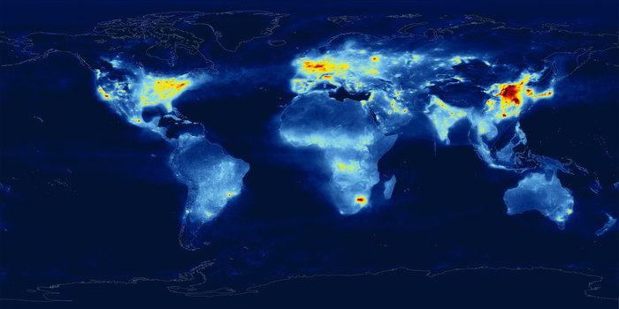
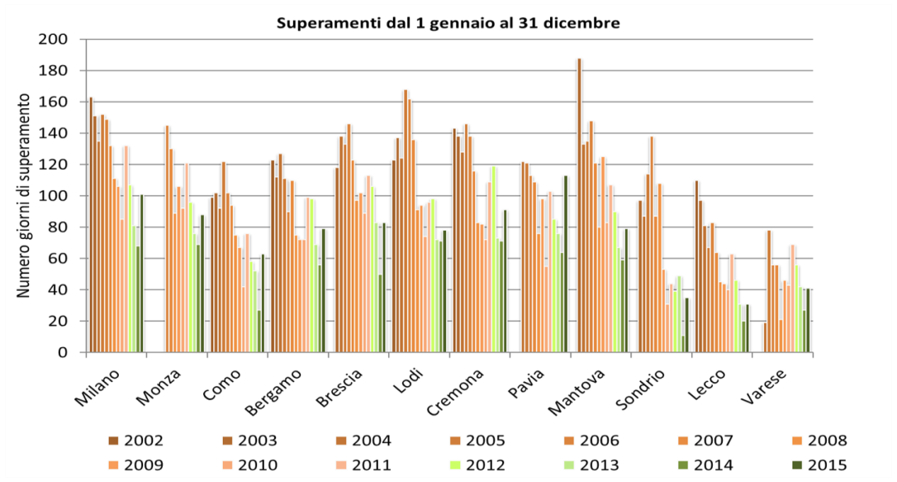
Air Quality: A Global Problem
Particulate Matter (PM)
Nitrogen oxides (NOx)
Ozone (O₃)
Sulphur oxides (SOx)
NOx conc. from ESA satellite (2010)
In Lombardy, all towns systematically exceed the limit of 35 days per year with average daily PM10 concentration below 50 μg/m³

Slide 2
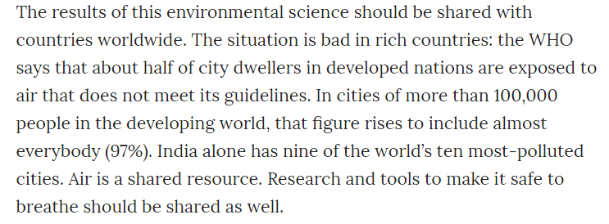

Slide 3
Air quality models
DETERMINISTIC MODELS
EULERIAN MODELS
LAGRANGIAN MODELS
Gaussian
Grid
Trajectory
Particle
Box/Puff
LOCAL
LAM
WIDE AREA
SHORT TERM
LONG TERM
Special conditions

Slide 4
The Gaussian plume model
Consider again the general transport-diffusion equation:
+ chemical reactions + net input
Under the following assumptions:
Stationary process (no change in time)
Homogeneous and flat spatial domain
Wind speed V direction along z₁ (only) i.e. v=0 along other axes
Negligible dispersion along z₁
No chemical reaction
Only a (constant) source in (0,0,0) equal to Q
Known background concentration C_{b}
The equation can be solved analytically and gives:

Slide 5
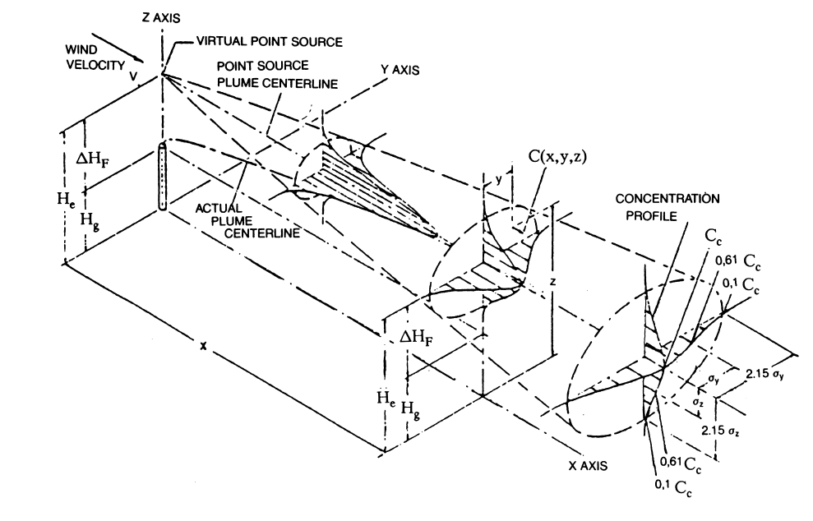
The Gaussian plume model - 2
Denoting:
(dispersion coefficients)
The equation can be written:
which is the equation of a double Gaussian surface with standard deviations σ_{y} and σ_{z}.
The peak concentration corresponds to the emission “height” and decreases with distance; along the other two axes the distribution is Gaussian with increasing dispersion.

Slide 6
The Gaussian plume model - 3
The concentration in each point of the space is PROPORTIONAL to the emission Q and INVERSELY PROPORTIONAL to the wind speed V.
Two necessary “adjustments”:
- The plume is (mostly) emitted at a certain elevation H_{e}≠ 0
- The pollutant does not diffuse in the soil (perfectly reflective)
The equation becomes:

Slide 7
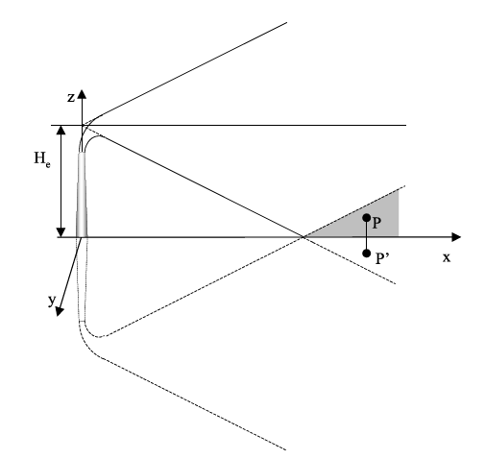
The Gaussian plume model - 4
The concentration produced by the source in (0,0,H_{e}) is summed to the concentration that would have been produced by a “virtual” equal source in (0,0,−H_{e}).
The effective height H_{e} is different from the actual high of the stack H.
This is due to:
The inertia of the emitted plume
The temperature difference with the environment

Slide 8
The Gaussian plume model - 5
Various formulas have been proposed for the calculation of the effective high.
They differ for:
Buoyant plumes (the effect of the temperature difference is prevailing)
Ex.
where V_{e} is the speed of emitted gas, d is the stack diameter, Q_{h} is the enthalpy of the emitted gas (which depends on the temperature difference)
Jet plumes (the effect of the emission speed is prevailing)
Ex.
Many other formulas based on empirical (actual measurements) or theoretical considerations. See, for instance, “Effective stack high – Plume rise” by US EPA.

Slide 9
Exercise
A constant SO₂ emission for a coal fired power plant produces a 30 μg/m³ concentration on a sensor 2 km apart when the wind speed is 5 m/s.
What will be the concentration when reducing the emission by 30% when the wind speed is 3 m/s?
25.2 μg/m³
12.6 μg/m³
35.0 μg/m³
28.5 μg/m³

Slide 10
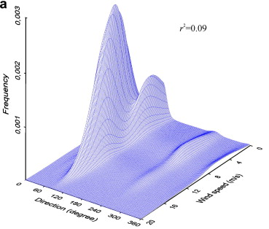
The role of meteorology
The form of the plume thus depends on the wind speed and direction, the air temperature, the overall stability of the atmosphere.
For the application of the Gaussian model, they must be CONSTANT.
Such an assumption can be considered valid on short time intervals (e.g. 3 hours or less) and the different situations are often defined by a range of meteo values.
For instance, the wind direction that may span 360° (real number) is categorized in 36 (0°-9°; 10°-19°;…) or 18 (0°-19°;…) classes.
The number of occurrences of certain combination of values, e.g. wind speed and direction, in a certain year, is reported in suitable tables (~ probability of occurrence).

Slide 11
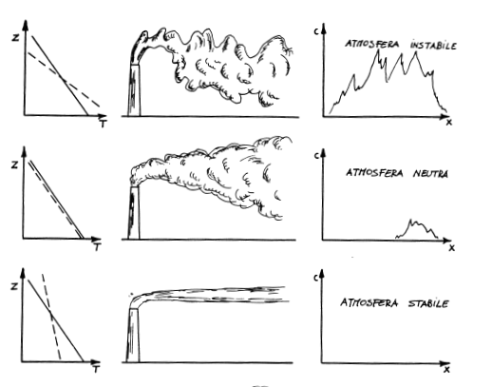
The role of meteorology - 2
The stability of the atmosphere is particularly important since it determines how fast the plume mixes with the local atmosphere.
To classify the atmospheric stability conditions one normally refers to the natural temperature decrease with the height (adiabatic gradient): dT/dz₃=g/Cp=0.0098°C m⁻¹
The actual gradient is lower than the adiabatic one ⇒ instability
The actual gradient is equal to the adiabatic one ⇒ neutral conditions
The actual gradient is higher than the adiabatic one ⇒ stability

Slide 12
Pasquill-Gifford classes
A classical way to classify stability conditions is to refer to the classes proposed by Pasquill and Gifford (1977) :
class | definition | gradient (°C m⁻¹)
A | Extremely unstable | <-0.019
B | Moderately unstable | -0.019 ÷ -0.017
C | Slightly unstable | -0.017 ÷ -0.015
D | Neutral conditions | -0.015 ÷ 0.005
E | Slightly stable | 0.005 ÷ 0.015
F | Moderately stable | 0.015 ÷ 0.04
G | Extremely stable | >0.04
Wind direction sd °
25
20
15
10
5
2.5
1.7

Slide 13
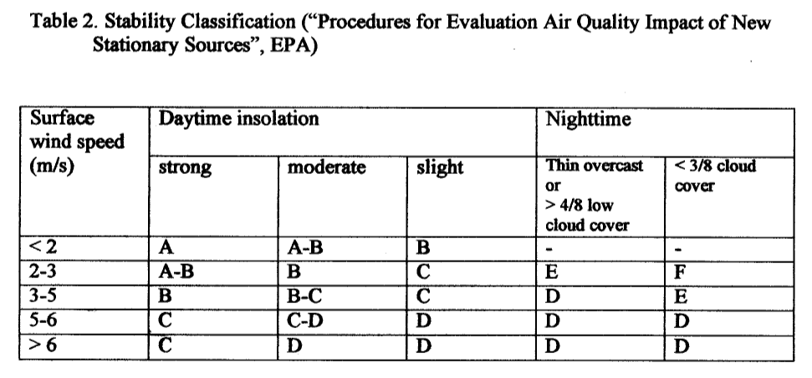
Pasquill-Gifford classes - 2
Other classification are possible:

Slide 14
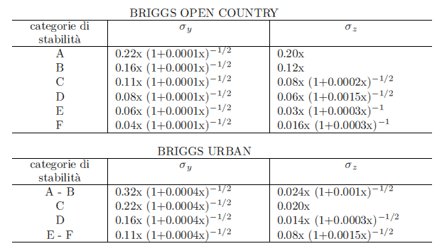
Stability and dispersion
Given the stability conditions, different formulas have been proposed to parametrize the dispersion.
Ex. Briggs (1969, 1971, 1972), where x is the distance from the source (100m<x<10km) and we compute average half-hourly concentrations:
Stability class
The effect of buildings in an urban environment increases the dispersion of pollutant (higher σ values)
Stability class

Slide 15
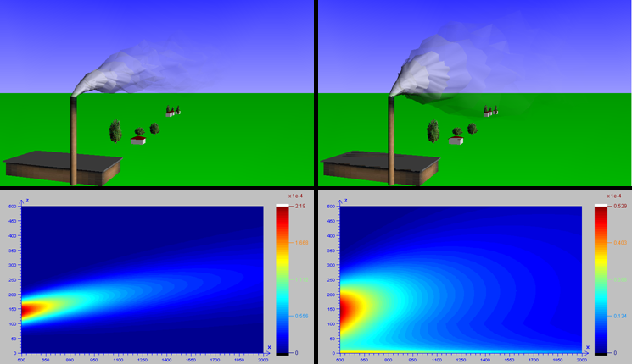
Atmospheric stability
E(moderately stable) B (moderately unstable)
More dispersion = lower concentration in B (scales are different)

Slide 16
The climatological model
How to compute an “average” concentration over a long period (one month, one year)?
We assume that the period is just a sequence of different stationary conditions, disregarding the transient between one condition and the following.
Assuming that the concentration C_{m} is computed for the meteorological condition m and that condition has probability p_{m} of occurrence, then the average concentration
which means that prevailing meteo conditions are weighted more.
Note that a meteo condition is defined by a class of stability, of wind speed, wind direction, and temperature (3 h conditions in a year = 2920 occurrences; ex. Class F, wind < 0.5, 15<T<18°C occurred 320 times, that is p_{m} ~ 320/2920 = 0.11).
Note that anyway an annual average varies less and thus it is easier to replicate.
The performances of the model may strongly vary with the position.

Slide 17
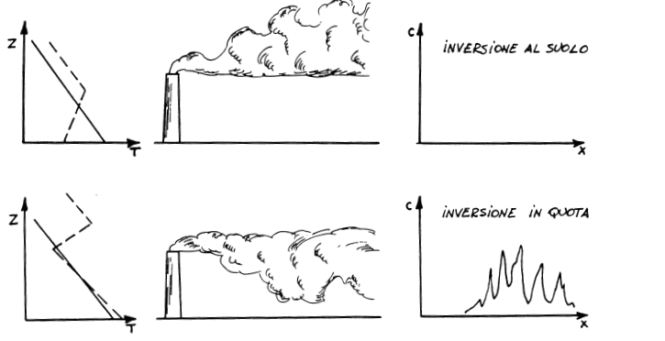
Other relevant meteo conditions
The temperature gradient changes sign with elevation
Low level temperature inversion
High level temperature inversion
Typical of Winter mornings when the soil temperature is very low.

Slide 18
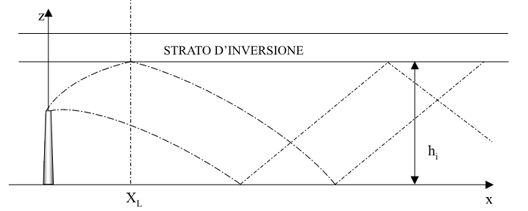
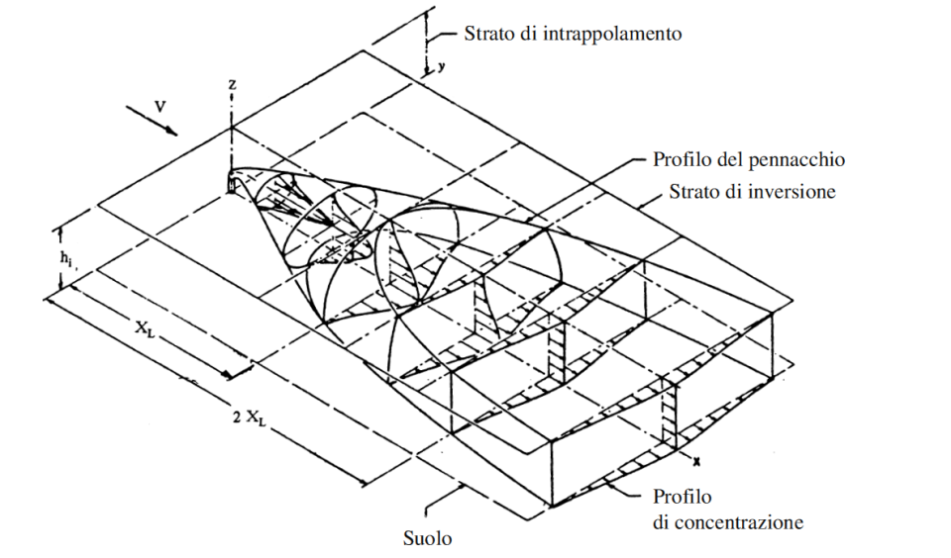
Gaussian correction for inversion
Assumption similar to terrain reflection, i.e. many virtual sources above the inversion layer (and below the terrain surface)
Inversion layer

Slide 19
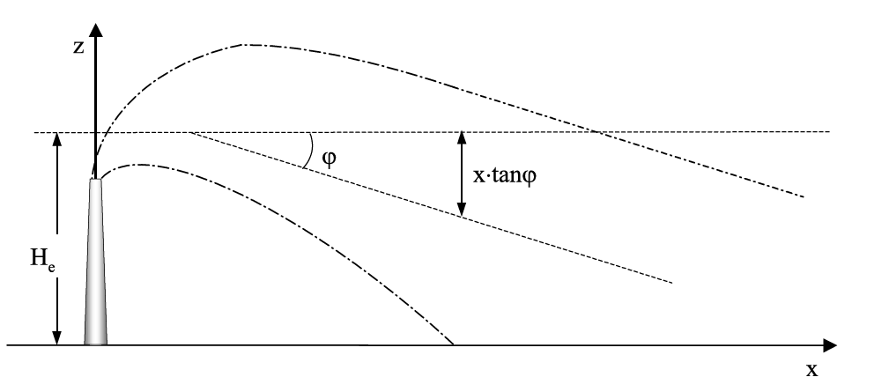
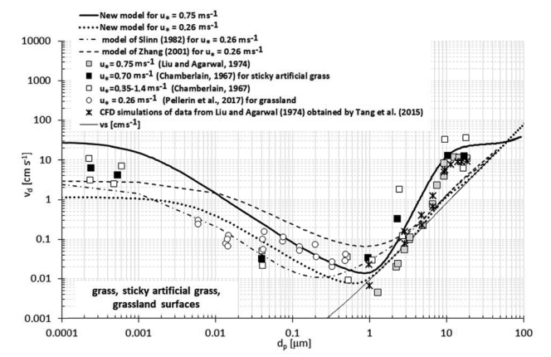
Particulate matter
The standard Gaussian plume formulation can be adjusted to account for PM deposition.
The plume axis is deviated by a certain slope ϕ that depends on the deposition speed of the various particle sizes.
Subdividing the emission in N classes, k=1,…, N
Where:
Q(k) is the emission in class k,
H_{e}=H+ΔH− v_{g}(k)z₁/V ,
v_{g}(k) is the dry deposition speed of class k, computed as
d(k) and ρ(k) being diameter and density of class k, and μ the dynamic viscosity of air.

Slide 20
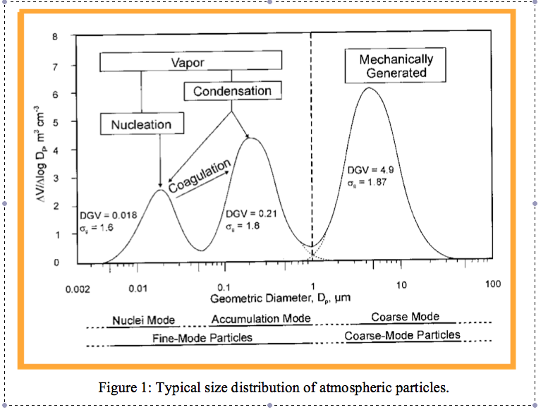
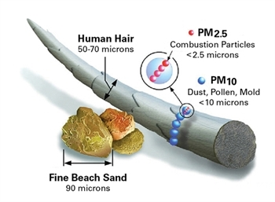

Slide 21
(Standard) model performances
Several performance indicators have been proposed (and partly standardized) for air quality models. They can be grouped into two categories:
General statistics: Root Mean Square Error (RMSE), correlation coefficient (R), Normalized Mean Bias (NMB), Normalized Mean Standard Deviation (NMSD) and Centered Root Mean Square Error (CRMSE) (M model results, O measures).

Slide 22
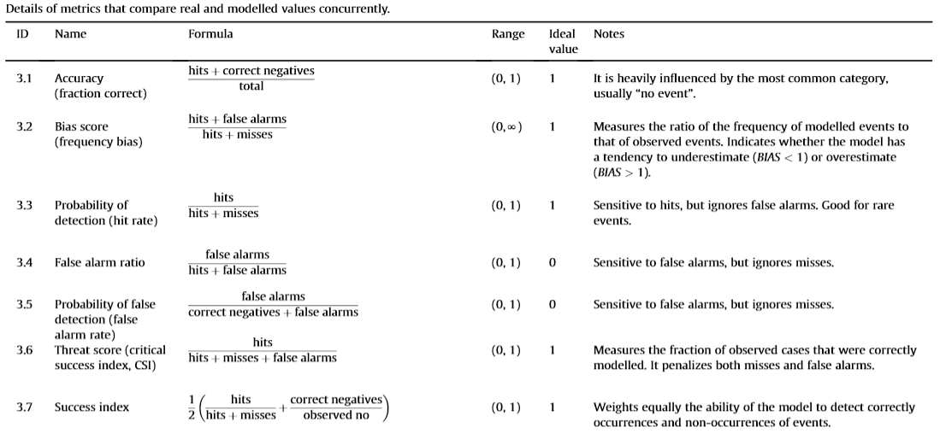
(Standard) model performances 2
- Episodes (hits = correct values above a given threshold)
Note that, given that the norms refer to “any station above the threshold” modelling the location correctly may non be relevant for decision purposes.

Slide 23
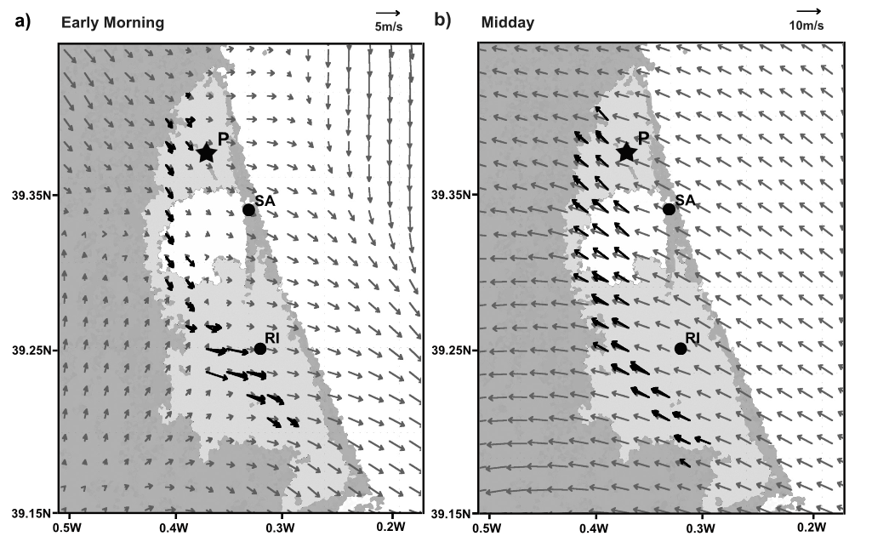
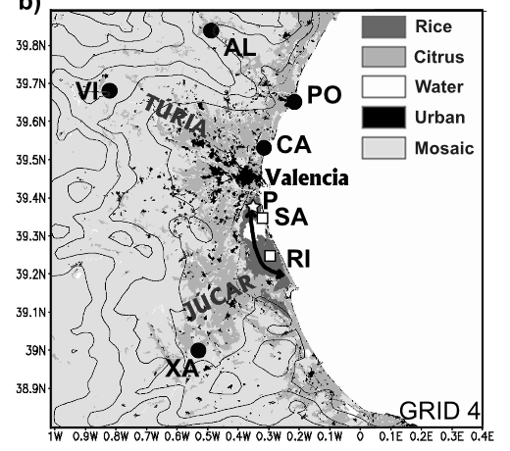
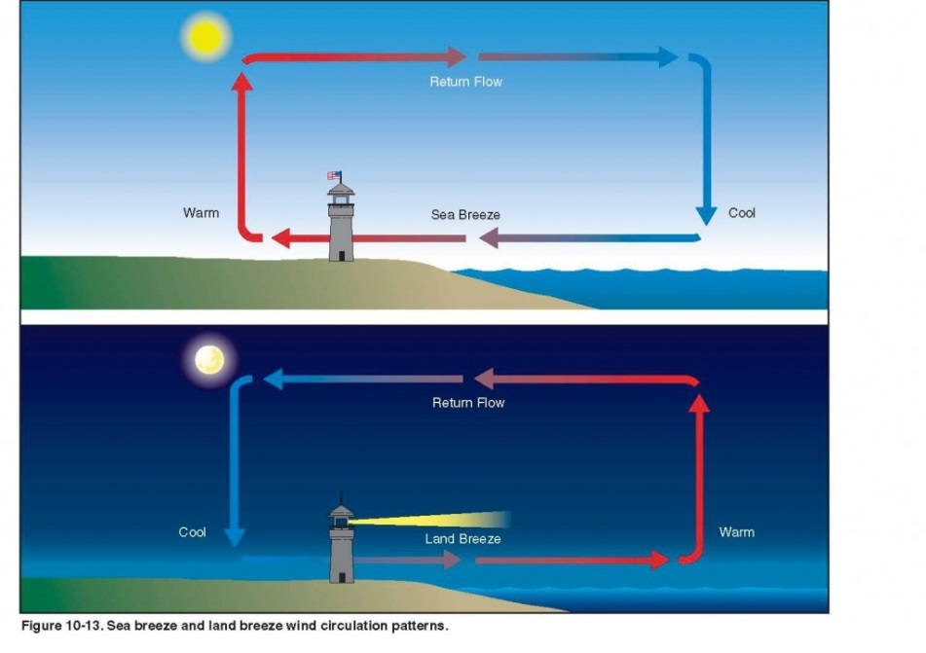
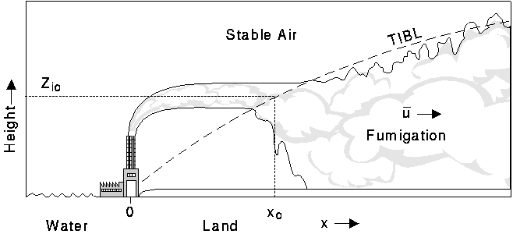
Mountain breeze: uphill during the day, downhill during the night
See breeze: from the sea during the day, to the sea during the night (TIBL = Thermal Internal Boundary Layer)

Slide 24
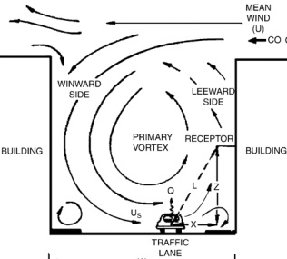
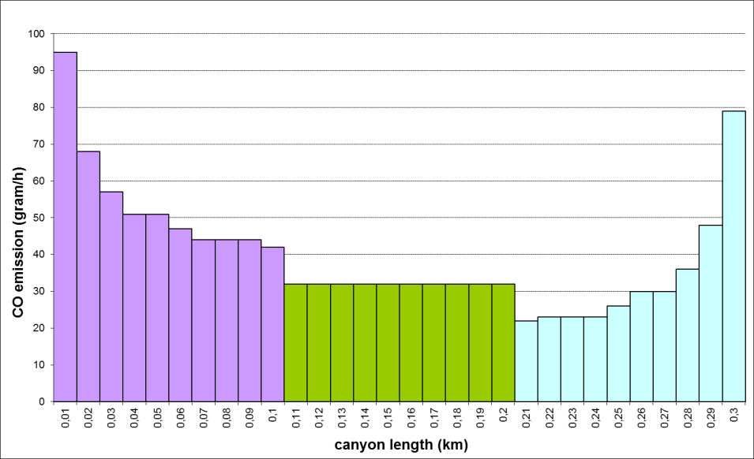
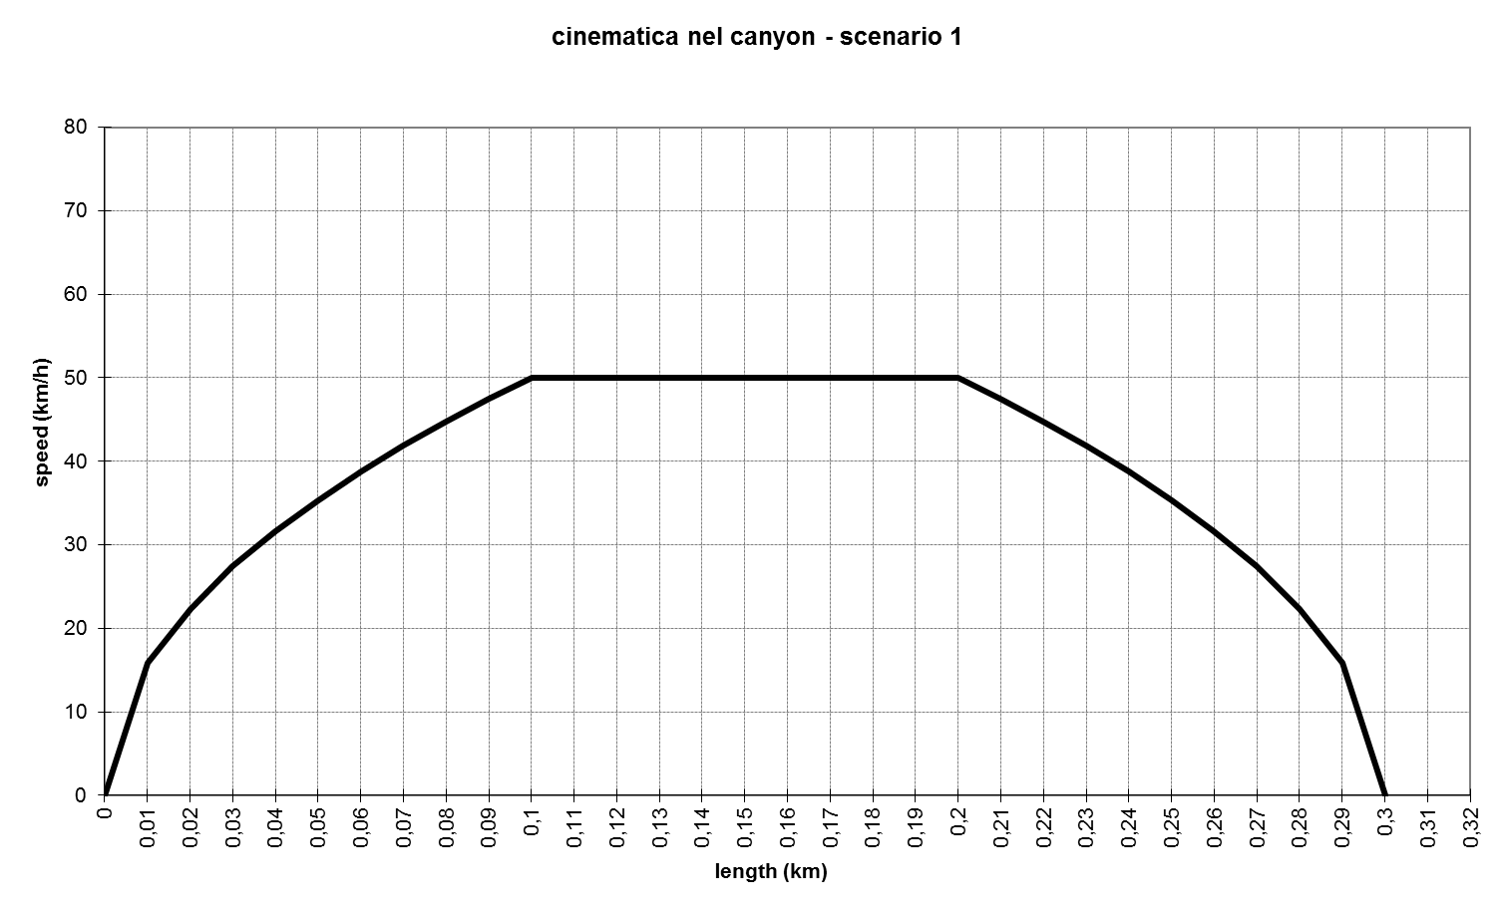
The urban canyon
Natural (wind) plus traffic induced turbulence must be taken into account. Traffic is prevailing for low wind speed.
Important: (modal) emissions in a real urban street are much higher close to the crossroad.
Many consecutives adjusted Gaussian plumes

Slide 25
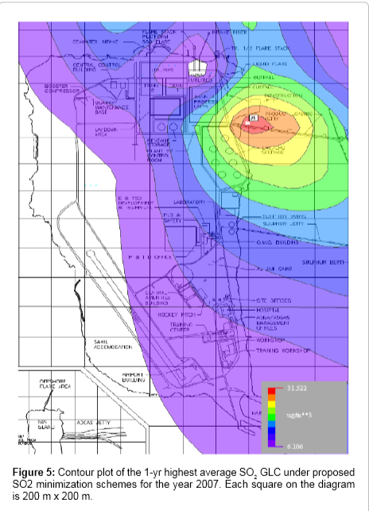
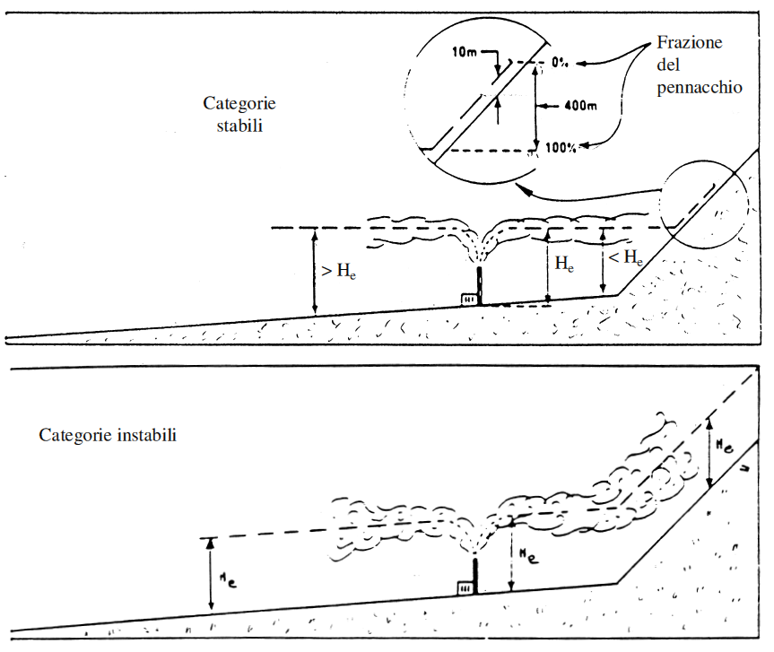
Recommended code
AERMOD Modeling System - A steady-state plume model that incorporates air dispersion based on planetary boundary layer turbulence structure and scaling concepts, including treatment of both surface and elevated sources, and both simple and complex terrain.
Fraction of the plume
Stable conditions
Unstable conditions

Slide 26
The Puff model
A critical aspect of the Gaussian equation:
is that it cannot be used when the wind speed V is low (< ∼ 0,5 m/s).
We can discretize the emission in a series of puffs, each moved by wind (center of gravity) and with an internal Gaussian distribution.
First, the position of the center of gravity of each puff is computed (advection).
Then contribution C’ of each puff (of mass M) to the concentration in (dispersion) is computed:

Slide 27
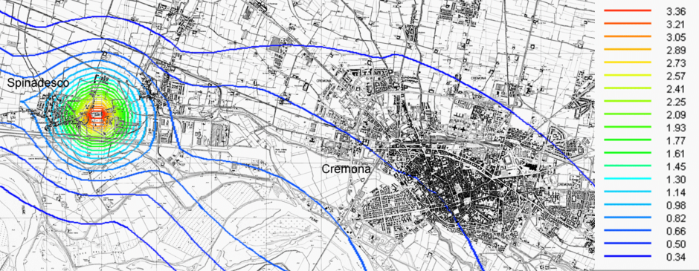
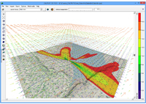
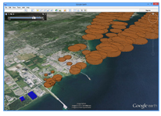
The Puff model - 2
The advantage is that it can be used in calm and varying wind conditions (and is still linear in the emission).
The disadvantage is that it requires more data and calculations.
Needs a meteo preprocessor to compute 3D wind fields.
It may also account for some chemical process inside each puff.
Recommended: CALPUFF

Slide 28
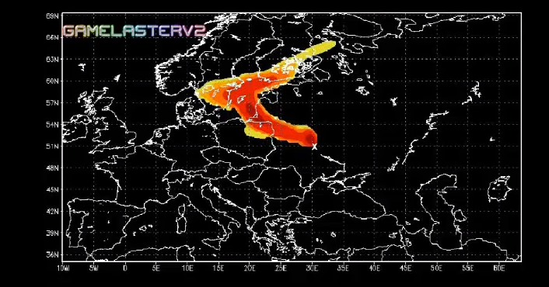
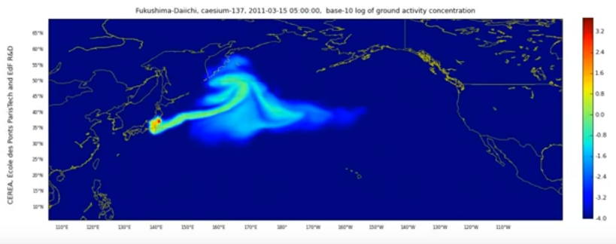
Long range transport
For long range effect to be meaningful, the pollutant must decay slowly (> several days).
Diffusion is negligible wrt advection.
Winds at high elevations are usually much stronger (and persistent).
Cesium-137 Chernobyl, April1986
Cesium-137 Fukushima September 2011

Slide 29
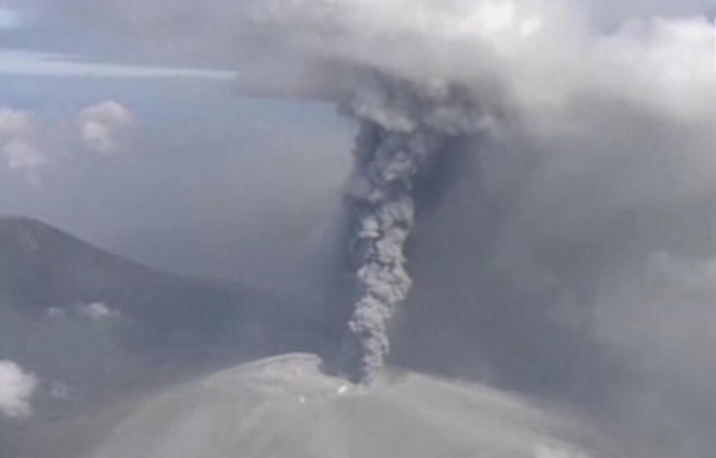
Shinmoedake volcano (Japan), Oct 12, 2017
2 km

Slide 30
Linear models and planning
Assume a certain meteo condition m, and a known position of a RECEPTOR, its concentration is (assuming, for instance, the SOURCE in (0,0,0)):
where refer to a specific position and meteo condition.
The formula means that, in this case, the concentration at the receptor site can be written as
i.e., with a proportionality constant α depending only on the meteo condition and the relative position of receptor and source (= a linear S/R function).
If the source is constant for a long period (e.g. a year) and we know the probability p_{m} of occurrence of each meteo condition, we can compute the average pollution at the receptor site due to the source:

Slide 31
Linear models and planning - 1
For a set of meteo condition m, the concentration at a receptor at ground level (z₃=0), is (the SOURCE is always assumed in (0,0,0) and the wind direction along z₁):
m=1 m=2
receptor
wind
receptor
z₂
z₁, z₂=0
z₁
wind
source
source

Slide 32
Linear models and planning - 2
We can thus solve problems such as:
What maximum emission may a certain source have without creating an intolerable average concentration at a given location?
a linear problem
What is the maximum emission that guarantees an acceptable average concentration with a given probability (e.g., number of days per year)?
a linear problem for known set of meteo condition; a mixed integer program if the meteo conditions must be selected (additional decision variables):

Slide 33
Linear models and planning - 3
What is the minimum abatement cost of a set of sources that guarantees a given concentration at a receptor site?
where Cost_{i}(Q_{i}) are the abatement costs at sources i that depend on the emission.
How large are the emissions at given locations S_{i} that determine a measured concentration at a certain site (source apportionment)?
In case of many observations in different meteo conditions

Slide 34
Linear models and planning - 4
These can easily be extended to a network of receptors.
Find the optimal abatement rates of a set of plants, to guarantee a given average concentration C* on a given measurement network.
i=1,…, N: plants
j=1,…,S: measurement stations
m=1,…, M: meteorological conditions
E_{i} : planned plant emission (decision variable)
E_{i}^{CLE}: emission corresponding to the Current Legislation
where p_{m} is the probability of occurrence of meteo condition m, and E^{MFR} is the emission obtained adopting the Maximum Feasible Reduction .
The cost is a function of the abated emission

Slide 35
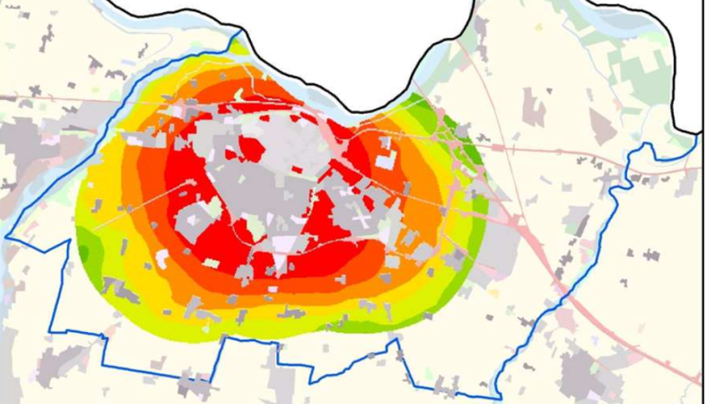
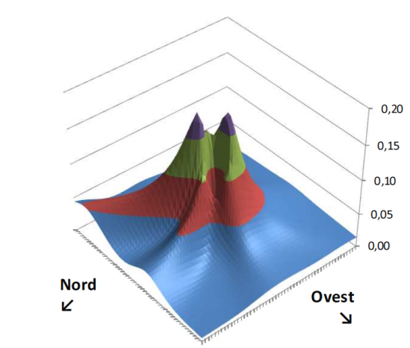
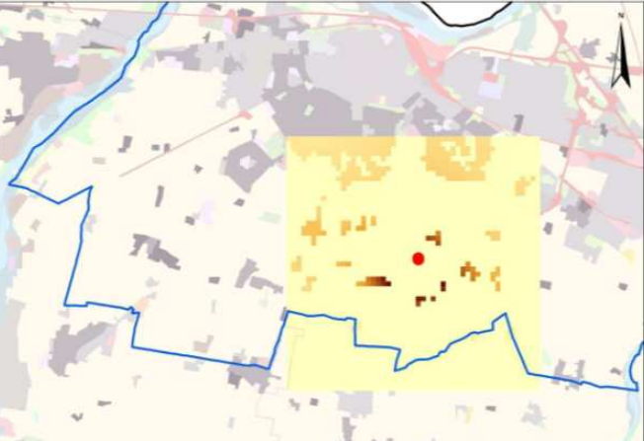
Linear models and planning - 5
Find the best position of a plant with emission E(j) on a grid of feasible positions g.
m=1,…, M: meteorological conditions
j=1,…,S: receptor sites with population density P_{j}
g=1,…, G: grid elements in the domain
A linear INTEGER programming problem (the solution is a grid position g)
WARNING: the objective function has no physical meaning.
The concentration is weighted by the population density as this is related to the health damages
Piacenza

